Slide 1
Dynamic Urban Deprivation Monitoring (Space - Time Index)
How to identify vulnerability in time and space?
Milana Romanova

Slide 2
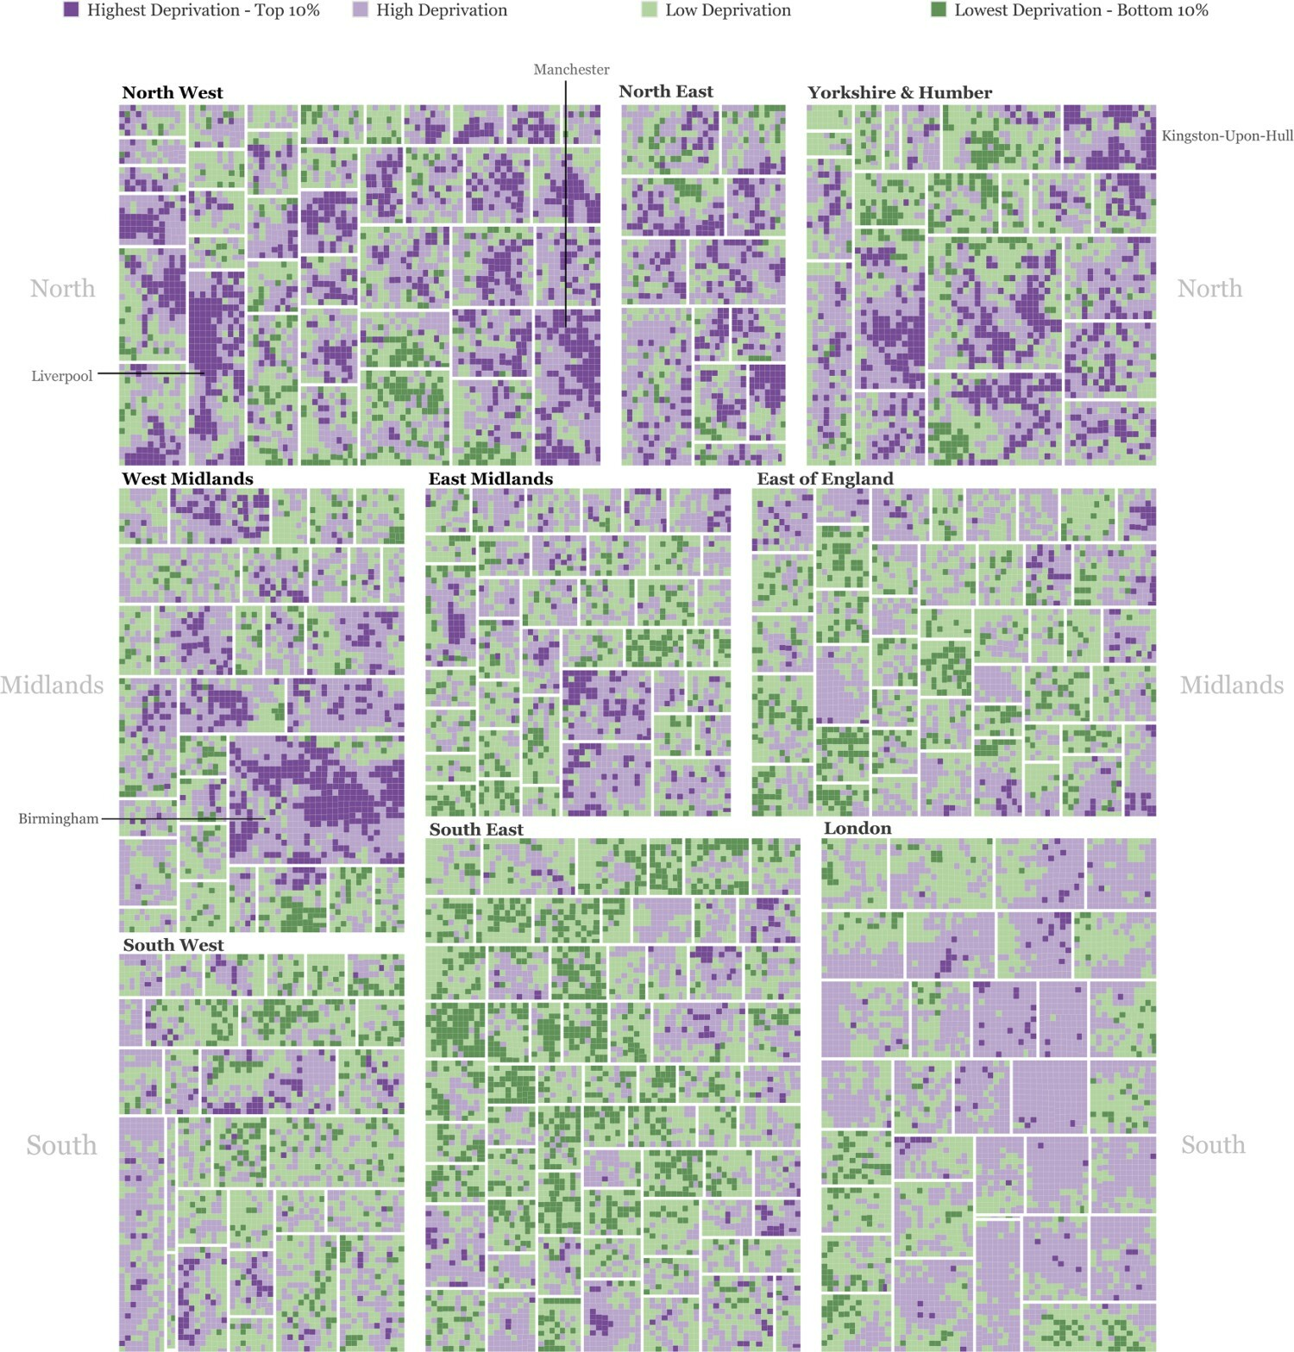
Content
Deprivation Index Concept
Space - Time Index:
Definition
Application
Relevance
Conclusions
References

Slide 3
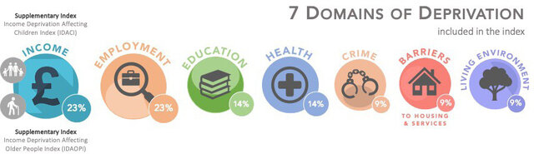
Deprivation Index Concept
– composite, area-based measures to quantify socioeconomic disadvantage
Main purpose is to…:
measure unmet needs and lack of resources across multiple domains
analyse health inequalities
evaluate social policies

Slide 4
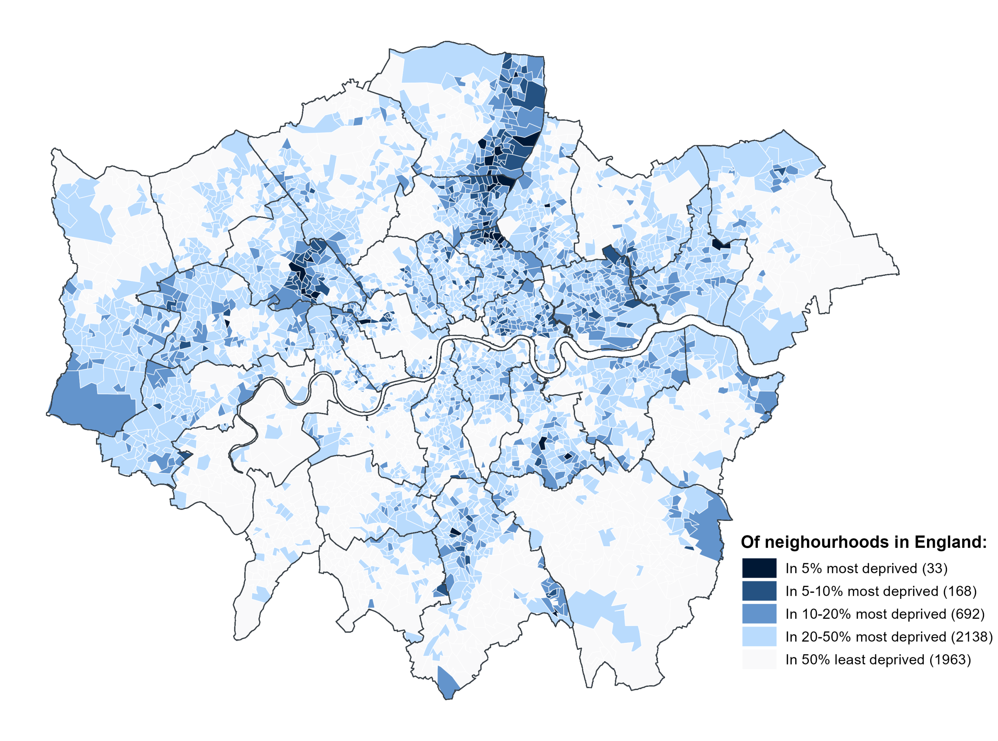
History of Deprivation Index Concept
Early 1980s: emerged in UK to measure material and social disadvantage
1983 (Jarman Index): identified areas with high GP workloads and patient needs
1988 (Townsend Index): deprivation based on unemployment, non-car ownership, non-home ownership, and overcrowding
2000s (Index of Multiple Deprivation - IMD): official, multi-domain indices, combining different indicators into a single score

Slide 5
Space - Time Index: Definition
– captures temporal fluctuations in social, functional, and environmental vulnerability across the time period
The index combines classic deprivation variables with time-sensitive indicators:
opening hours of amenities
day/night accessibility
temporal presence or absence of people and services
frequency of events

Slide 6
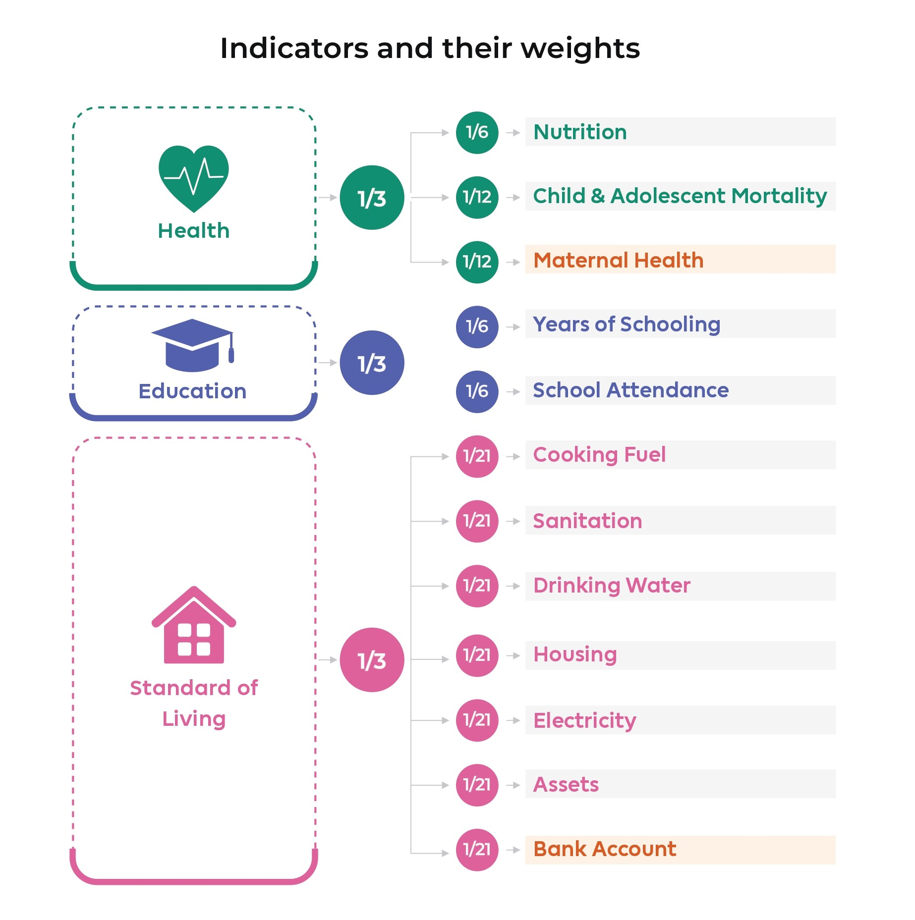
Space - Time Index: Application
Select deprivation dimensions and indicators (socio-economic status, access to services, environmental stressors)
Add a temporal layer by calculating indicators for different times (day/evening/night; weekday/weekend)
Normalize and aggregate to produce a space-time deprivation score for each neighbourhood
Map temporal vulnerability to identify when and where urban conditions deteriorate

Slide 7
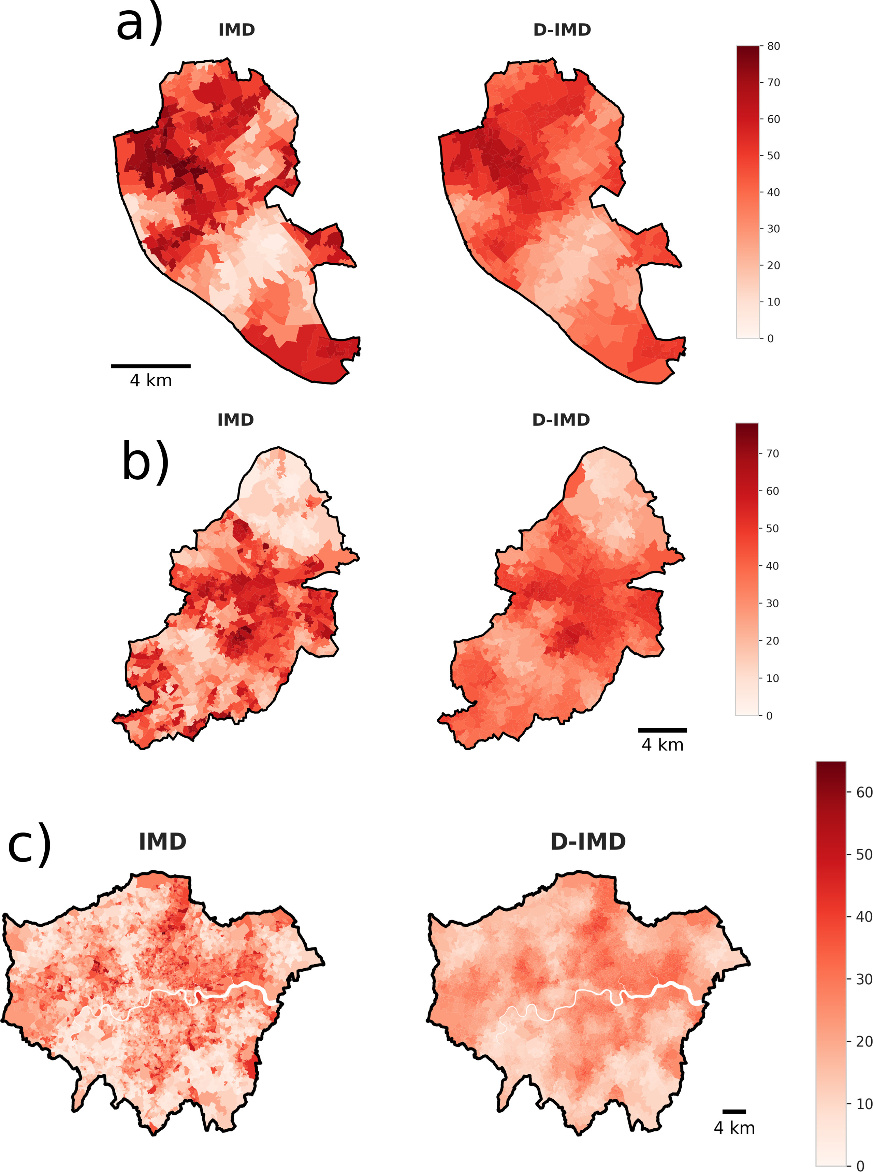
Space - Time Index: Relevance
Time parameter is often missed or overlooked in urban analysis. This method allows to:
move from static to dynamic urban inequality analysis
achieve more precise and realistic results
directly apply data to planning
supports targeted, time-specific interventions rather than limited area-based policies

Slide 8
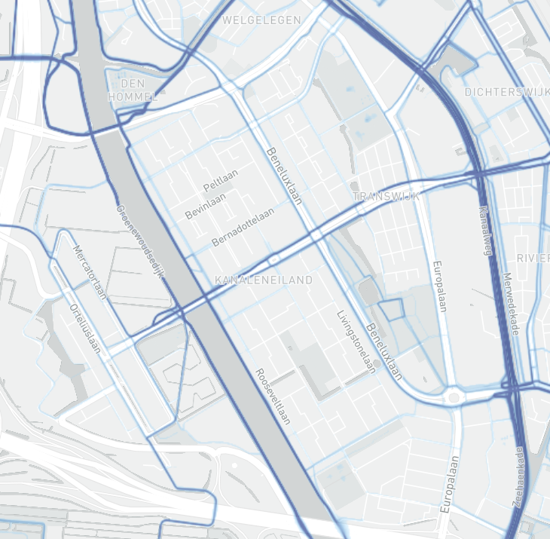
Conclusions
Pros:
Multidimnsional
Strong academic grounding
Easy to conceptualize: applicable for policy-makers
Scalable
Includes time aspect
Cons:
Micro-scale problems can be overlooked
Less-applicable in data-poor context
Does not represent actual behaviour
/However, use Behavioral Hotspot Analysis can solve this/
STRAVA tool

Slide 9
References
Alkire, S., & Foster, J. (2011). Counting and multidimensional poverty measurement
Galster, G. (2012). The mechanism(s) of neighbourhood effects
Kwan, M.-P. (2013). The uncertain geographic context problem
van Ham et al. (2012). Neighbourhood effects research in Europe

